Slide 1
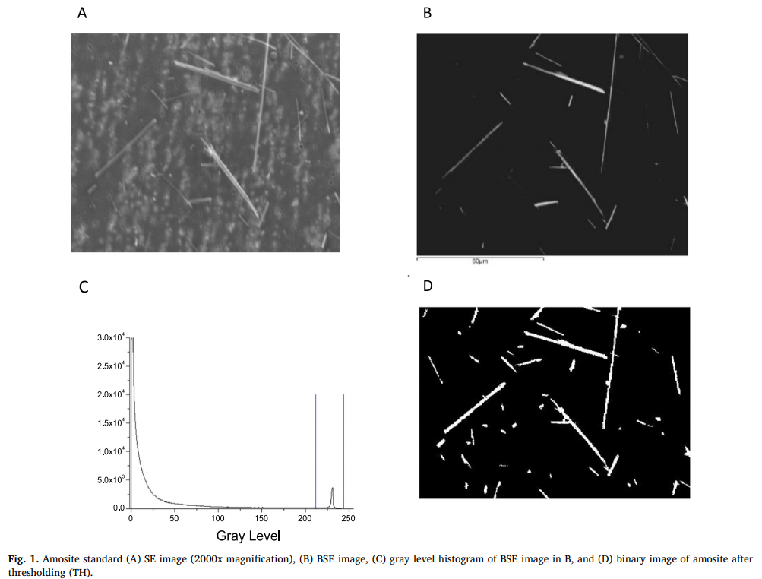
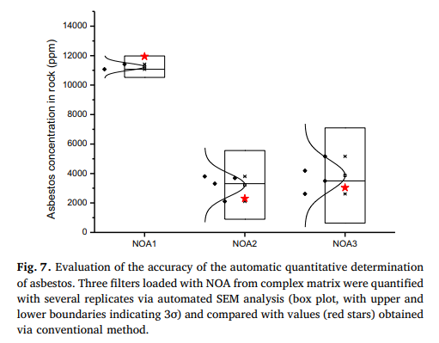
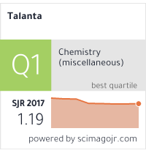
Innovative unattended SEM-EDS analysis for asbestos fiber quantification
Objective
To improve sensitivity and precision and enhance productivity, an unattended quantitative measurement of the asbestos fibers by SEM-EDS is proposed. The method identifies the particle shape first and determines their chemical composition later, saving EDS analytical time
Samples
Rock samples were preliminary grinded using a Jaw Cruscher 200 equipped with stainless steel breaking jaws and variable openings to obtain a size reduction from < 90 mm down to < 2 mm. The sample was screened using a sieve with opening size of 1 mm and it was divided again with the rotary sample divider. The coarse powder was wet-milled in isopropyl alcohol (liquid/solid ratio of 1:1). The suspension was then transferred to a non-ventilated oven set at 90 °C and isopropyl alcohol evaporated for ca. 1 h
Procedure
The SEM used was a Zeiss EVO MA10 with W or LaB6 source, equipped with an EDS (Oxford Instruments Inca Energy 250, X-Act SDD detector and the Feature package software)
The evaluation was developed with the following steps, Fiber counting and morphometry, Elemental asbestos discrimination, Precision and accuracy evaluation of asbestos standards and real samples
Conclusion
The proposed automatic method allows quantifying asbestos at low concentration with scalable precision and relies on the combined identification and classification of fibers deposited on a porous membrane by applying a morphometric and a compositional filter

